Slide 1

Part I (Summary):
MF Recommendation Retrieval as Similarity Search Problem

Slide 2
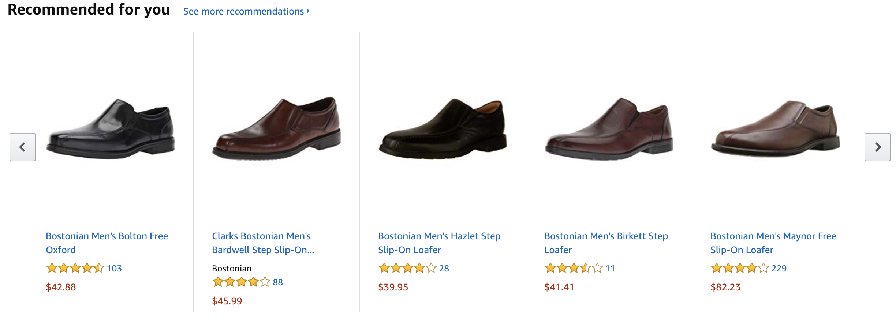

Solution: Recommender Systems

Slide 3















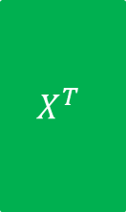










Two Phases of a MF Recommender System
$$n$$
$$d$$
$$n$$
$$R$$
$$X^{T}$$
$$Y$$
Learning
phase
$$m$$
$$≈$$
$$m$$
$$×$$
$$d$$
$$n$$
$$pref_{u}\left(i\right)=x_{u}^{T}{.y}_{i}$$
$$d$$
$$Y$$
$$n$$
$$×$$
$$d$$
$$=$$
$$pref_{u}$$
$$1$$
$$x_{u}$$
$$1$$
Retrieval
phase
$$n$$
Top-K items
$$1$$
Sorted $pref_{u}$

Slide 4
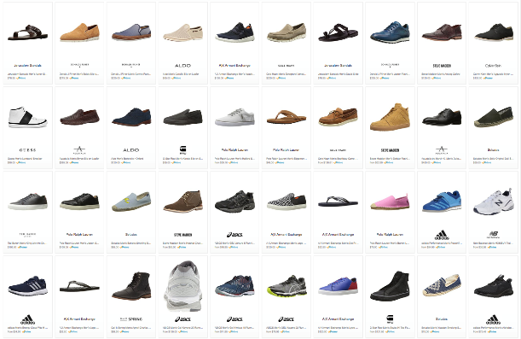
Choice Explosion
133,520 results for ”Men’s Shoes"

Slide 5
Scalable Recommendation Retrieval
Linear scanning may not be scalable for real-time retrieval
Indexing schemes do not work out-of-the-box for Maximum Inner Product Search (MIPS)
Strategy #1: Approximate MIPS
Learn the latent vectors from matrix factorization as usual
Apply post-hoc treatment or transformations to those vectors to enable approximation
Strategy #2: Indexable Representation
Design new matrix factorization techniques that would output natively indexable latent vectors
Compatible with LSH, spatial trees, or inverted index
Strategy #3: Discrete Representation
Learn a different representation altogether, e.g., binary codes
Inherently compatible with Hamming ranking or hashtable lookup

Slide 6
Part II C:
Approaches for Scalable Recommendation Retrieval
Discrete Representations
Slides available at
https://code.preferred.ai/recommendation-retrieval

Slide 7
Discrete Representation
Binary code for fast similarity search
Similarity measured in terms of Hamming distance
Number of bits to change to convert one code to another
Can be computed efficiently using XOR
Represent user and item as binary codes
user’s preference for an item as a function of their Hamming distance
Compatible with retrieval schemes
Hamming ranking (sorting is constant time due to integer distance)
Hashtable lookup
A 0 1 0 0 B 1 1 0 1
A XOR B 1 0 0 1
Hamming distance is 2

Slide 8
Discrete vs. Indexable Representation
Discrete Representation
Indexable Representation
Learn binary code representations
Learn real-valued representations
Transform into binary codes using data-independent hashing (LSH)

Slide 9



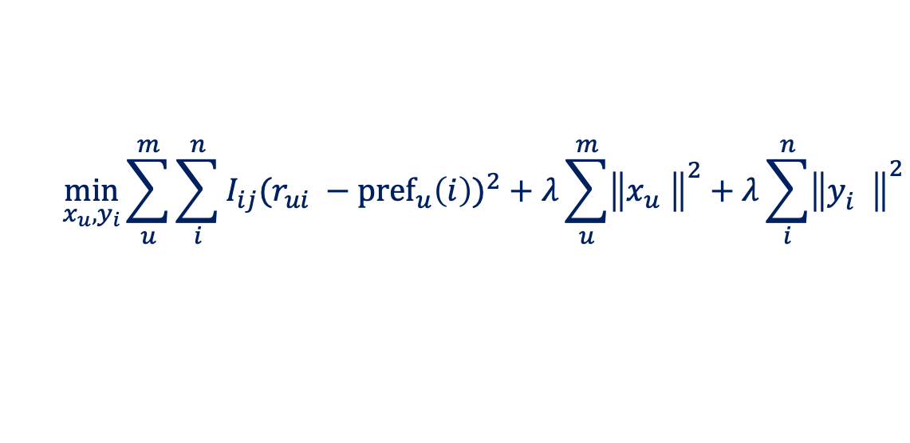
Discrete Representation for Explicit Feedback
Zhou and Zha, "Learning Binary Codes for Collaborative Filtering", KDD 2012.
Binary codes
$$x_{u}∈{\{−1, 1\}}^{b}$$
$$y_{i}∈{\{−1, 1\}}^{b}$$
$${pref}_{u}\left(i\right)={\frac{1}{2}+\frac{1}{2b}x_{u}^{T}{.y}_{i}}_{}^{}$$
Prediction
Learning Objective
$$\min_{x_{u}, y_{i}}{\sum_{u}^{m}{\sum_{i}^{n}{I_{ij}{(r_{ui} −{pref}_{u}\left(i\right))}^{2}}+λ\sum_{u}^{m}{{\left\|x_{u}^{}\right\|}^{2}}+λ\sum_{i}^{n}{{\left\|y_{i}^{}\right\|}^{2}}}}{}$$

Slide 10



Discrete Representation for Explicit Feedback
Zhou and Zha, "Learning Binary Codes for Collaborative Filtering", KDD 2012.
Learning Objective
$$\min_{x_{u}, y_{i}}{\sum_{u}^{m}{\sum_{i}^{n}{I_{ij}{(r_{ui} −{pref}_{u}\left(i\right))}^{2}}+λ\sum_{u}^{m}{{\left\|x_{u}^{}\right\|}^{2}}+λ\sum_{i}^{n}{{\left\|y_{i}^{}\right\|}^{2}}}}{}$$
Discrete optimization problems are intractable
Approximation:
real-valued relaxation
rounding to binary code
$$x_{u}∈{[−1, 1]}^{b}$$
$$y_{i}∈{[−1, 1]}^{b}$$

Slide 11
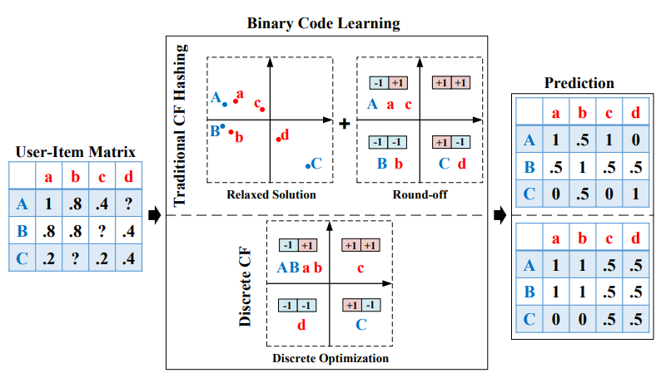
Discrete Representation for Explicit Feedback
Zhang et al., "Discrete Collaborative Filtering", SIGIR 2016.

Slide 12
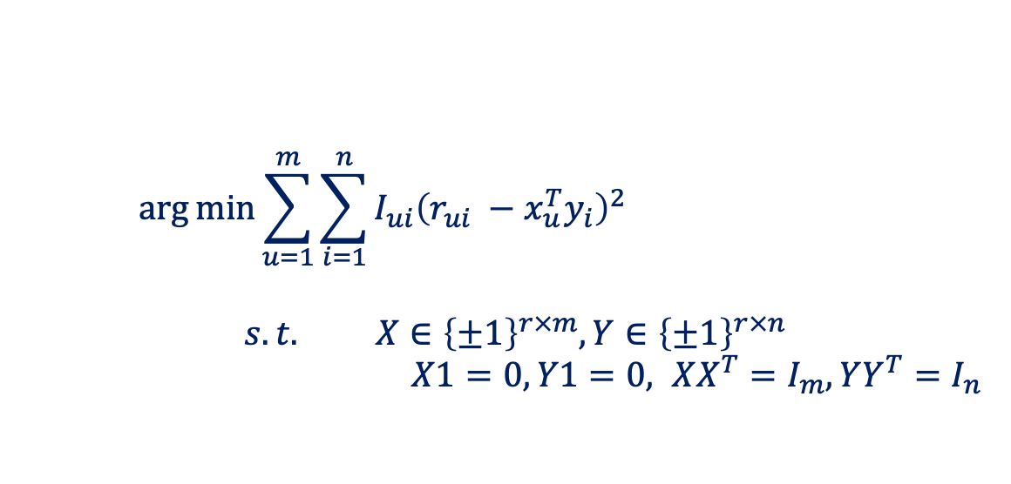
Discrete Representation for Explicit Feedback
Zhang et al., "Discrete Collaborative Filtering", SIGIR 2016.
$$\arg{\min{\sum_{u=1}^{m}{\sum_{i=1}^{n}{I_{ui}{\left(r_{ui} −x_{u}^{T}y_{i}\right)}^{2}}}}}$$
$$s.t. X∈{\left\{±1\right\}}^{r×m},Y∈{\left\{±1\right\}}^{r×n}$$
$X1=0, Y1=0, XX^{T}=I_{m}, YY^{T}=I_{n}$
Learning Objective
Constraints
Balanced
partitions
Decorrelation

Slide 13
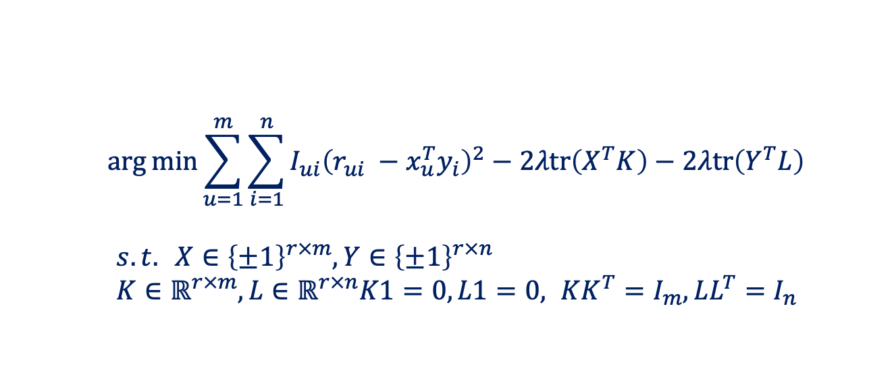
Discrete Representation for Explicit Feedback
Zhang et al., "Discrete Collaborative Filtering", SIGIR 2016.
$$\arg{\min{\sum_{u=1}^{m}{\sum_{i=1}^{n}{I_{ui}{\left(r_{ui} −x_{u}^{T}y_{i}\right)}^{2}−2λtr\left(X^{T}K\right)−2λtr\left(Y^{T}L\right)}}}}$$
$s.t. X∈{\left\{±1\right\}}^{r×m},Y∈{\left\{±1\right\}}^{r×n}$
$K∈ℝ^{r×m},L∈ℝ^{r×n}K1=0, L1=0, KK^{T}=I_{m}, LL^{T}=I_{n}$
Learning Objective
Constraints
Constraint relaxation
Alternating optimization
X and Y via discrete coordinate descent
K and L via SVD

Slide 14

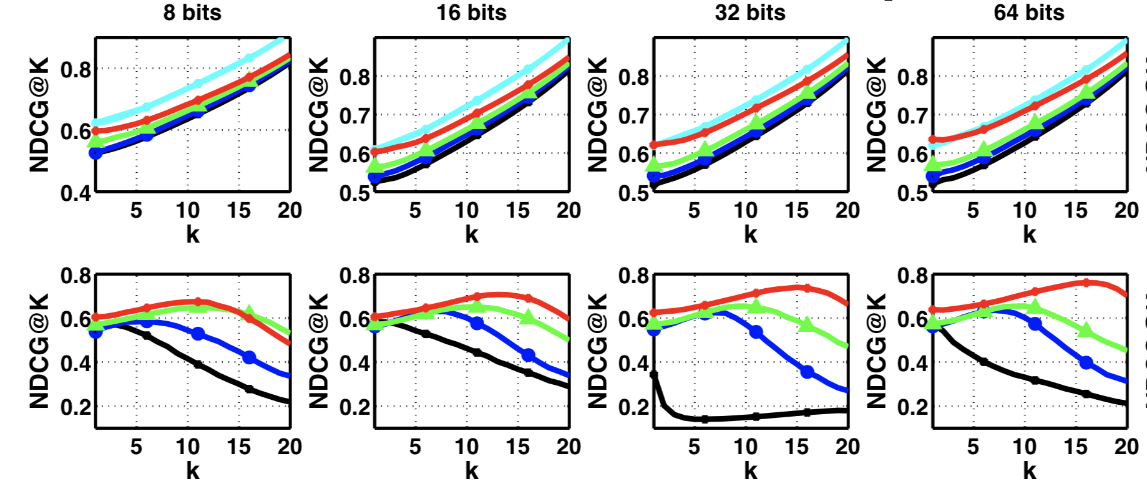
Discrete Representation for Explicit Feedback
Zhang et al., "Discrete Collaborative Filtering", SIGIR 2016.
First row: Hamming ranking
Second row: Hashtable lookup

Slide 15
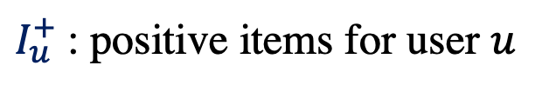
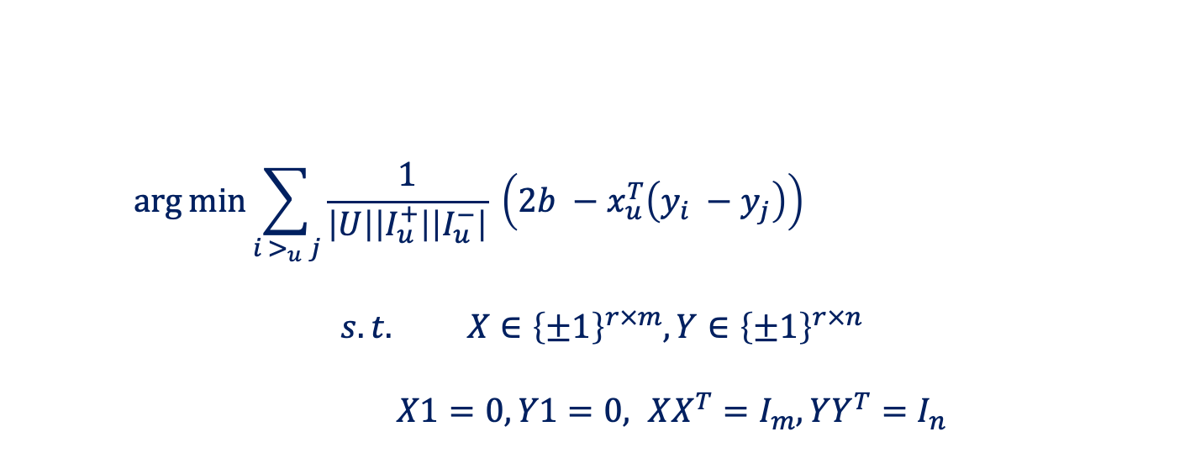
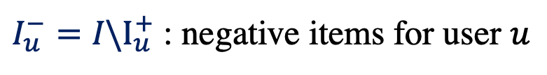
Discrete Representation for Implicit Feedback
Zhang, Lian, and Yang, "Discrete Personalized Ranking for Fast Collaborative Filtering from Implicit Feedback", AAAI 2017.
$I_{u}^{+}$: positive items for user $u$
$I_{u}^{−}=I\backslash I_{u}^{+}$ : negative items for user $u$
$$\arg{\min{\sum_{i{ >}_{u} j}{\frac{1}{\left|U\right|\left|I_{u}^{+}\right|\left|I_{u}^{−}\right|} \left(2b −x_{u}^{T}\left(y_{i} −y_{j}\right)\right)}}}$$
$$s.t. X∈{\left\{±1\right\}}^{r×m},Y∈{\left\{±1\right\}}^{r×n}$$
$X1=0, Y1=0, XX^{T}=I_{m}, YY^{T}=I_{n}$
Balanced partitions
Decorrelation

Slide 16
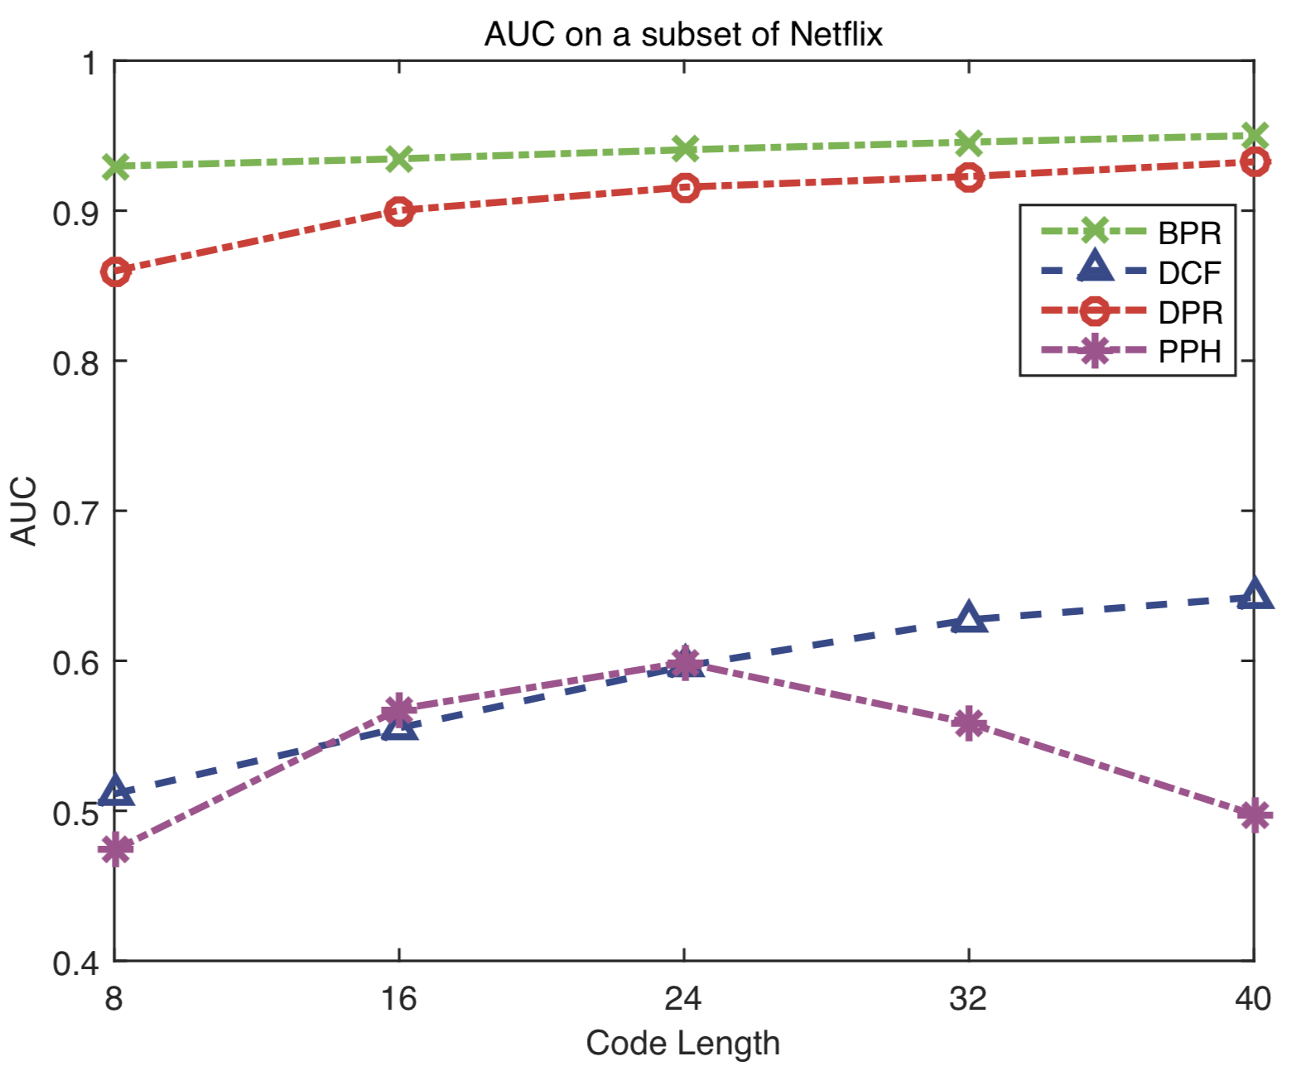
Discrete Representation for Implicit Feedback
Zhang, Lian, and Yang, "Discrete Personalized Ranking for Fast Collaborative Filtering from Implicit Feedback", AAAI 2017.

Slide 17
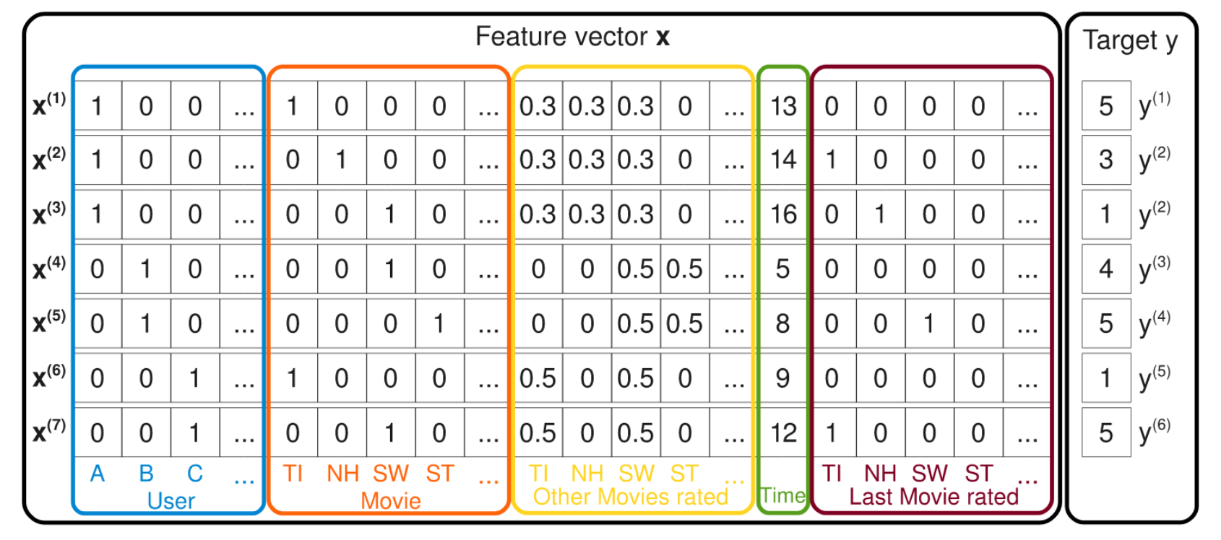
Feature-Based Recommendation
Rendle, "Factorization Machines ", ICDM 2010.

Slide 18
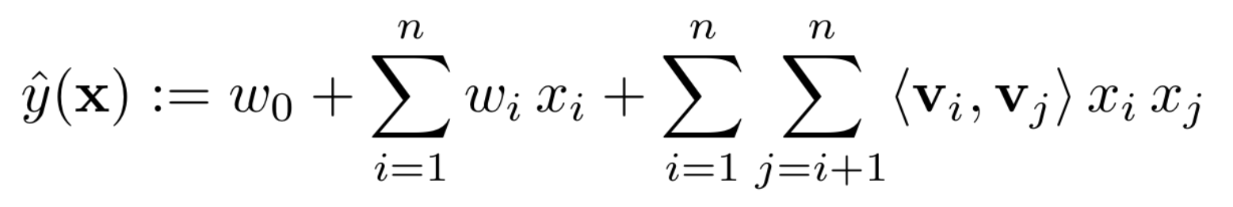
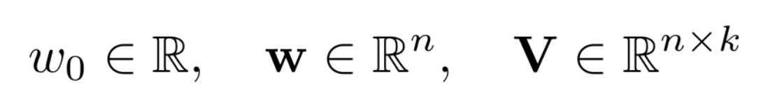
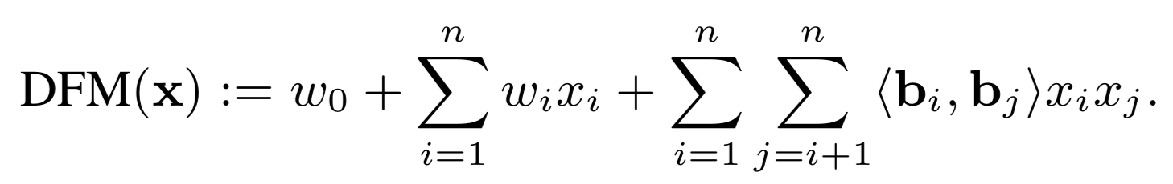
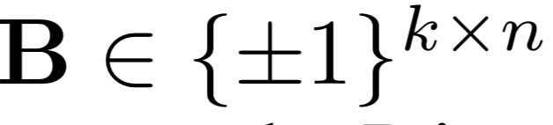
(Discrete) Factorization Machines
Rendle, "Factorization Machines", ICDM 2010.
Liu et al., "Discrete Factorization Machines for Fast Feature-based Recommendation", IJCAI 2018.
Factorization Machines
Discrete Factorization Machines

Slide 19
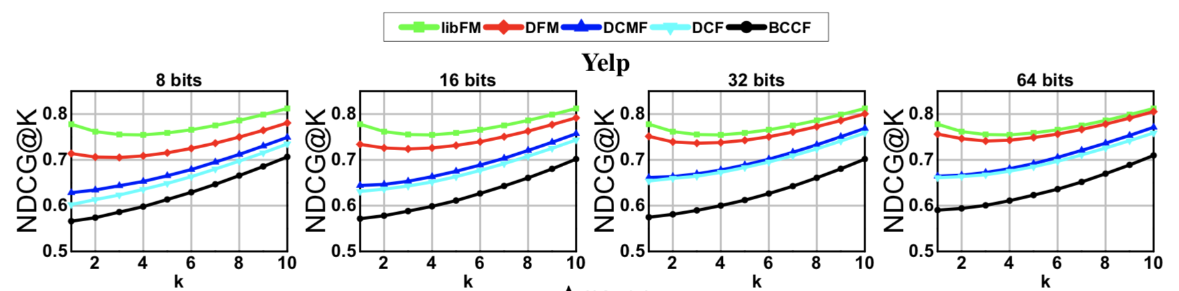
Discrete Factorization Machines
Liu et al., "Discrete Factorization Machines for Fast Feature-based Recommendation ", IJCAI 2018.

Slide 20
Summary
Learn discrete representations for users and items
Binary codes for Hamming ranking or hashtable lookup
Involves solving intractable discrete optimization problems
Variants for explicit (rating) and implicit (ranking) feedback

